Slide 1
Introduction to CSC3510
Whats the course about and How to do well…
How well do you play the game?

Slide 2

This course and its influences
CSC1700 and CSC2660 (OOP)
CSC3510 – software testing
CSC3700 – Adv Web App
CSC4350 (SE)

Slide 3
Course Composition
4
12
10

Slide 4




Slide 5
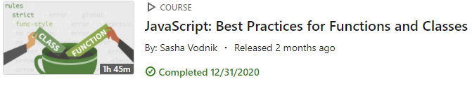
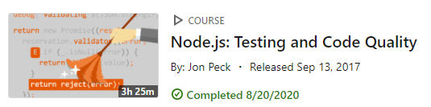
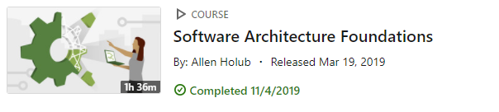
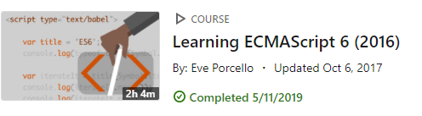
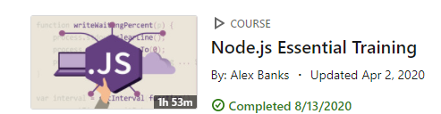
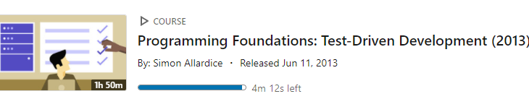
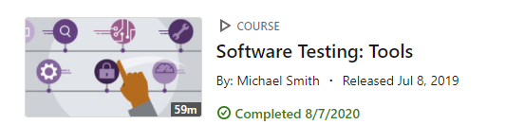
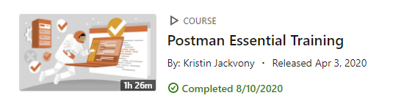

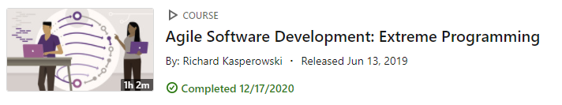
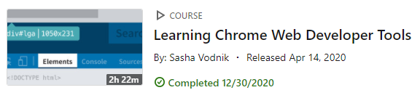
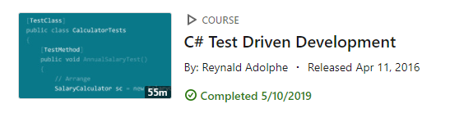

Slide 6
Java, HTML/CSS, JavaScript, Node.js
Tools to download
IDE’s IntelliJ, IDE WebStorm, GitHub Desktop

Slide 7
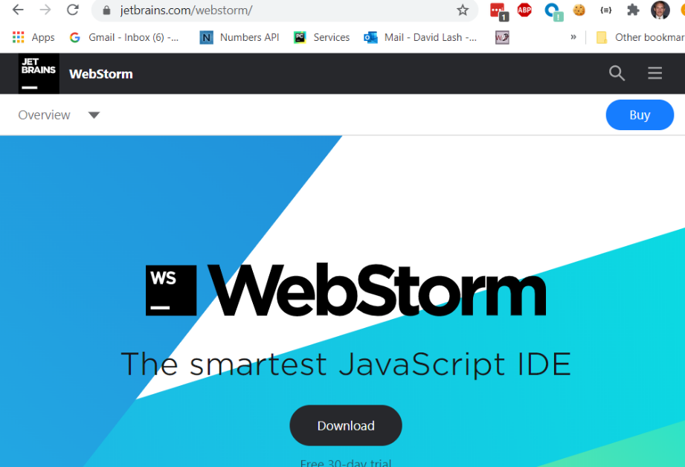

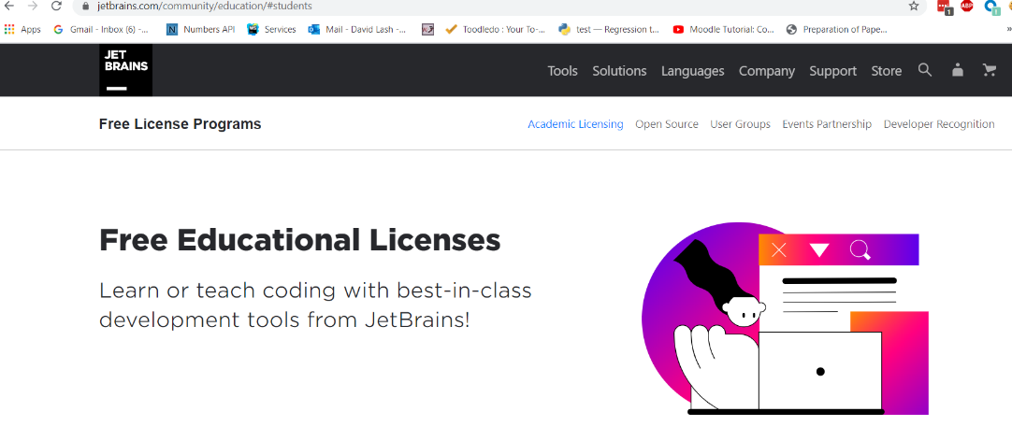
Technologies we will look at: Java, JS, Html/CSS, … Junit, Mocha, postman, Chai, node.js … and maybe others
There are many development tools that you can use to develop html/JS Applications
- We will use WebStorm and IntelliJ
1. https://www.jetbrains.com/webstorm/ apply for your free student edition: https://www.jetbrains.com/community/education/#students ... https://www.jetbrains.com/shop/eform/students

Slide 8
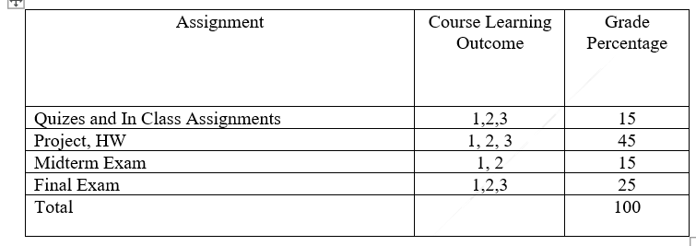
In class work … E.g., WOWs might have some quizzes
Weekly notes to hand in
HW Early on … will stop around the MT
Project work (more on this later)

Slide 9
Course-Level Objectives
1. Expand development skills needed to become a professional software developer
2. Understand and utilize tools, techniques, and processes, needed to develop quality software
3. Develop a software project that utilizes and showcases these new skills and techniques
Topics Covered in the Course
· Testing Concepts
· Agile EP testing roots (1)
· Code Reviews
· Java Review and Unit Testing in Java (2, 3)
· JS review and JS Unit Testing in (2)
· JS Code Standards (3)
· JS Debugging in JS (2)
· Node.js unit testing
· API Testing with PostMan

Slide 10
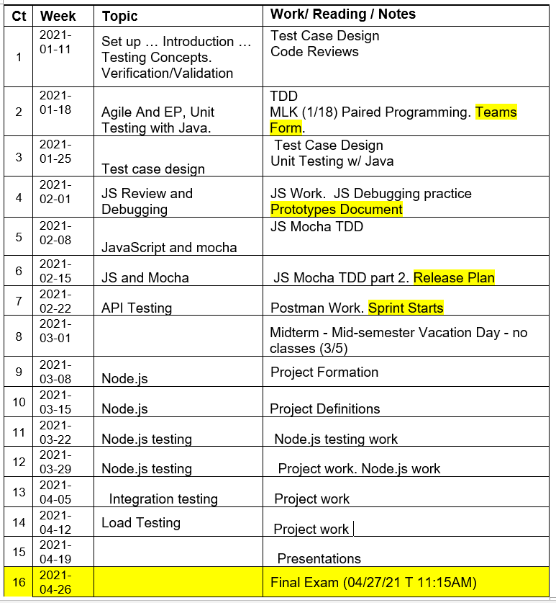
Teams form
Prototypes developed
Release Plan
Sprints Start
Status 1
Status 2
Status 3
Team Evals
Final Presentations

Slide 11

How your grade is determined – 15% In class work, quizzes and course notes
In class work … small little assignments that help you practice.

Slide 12
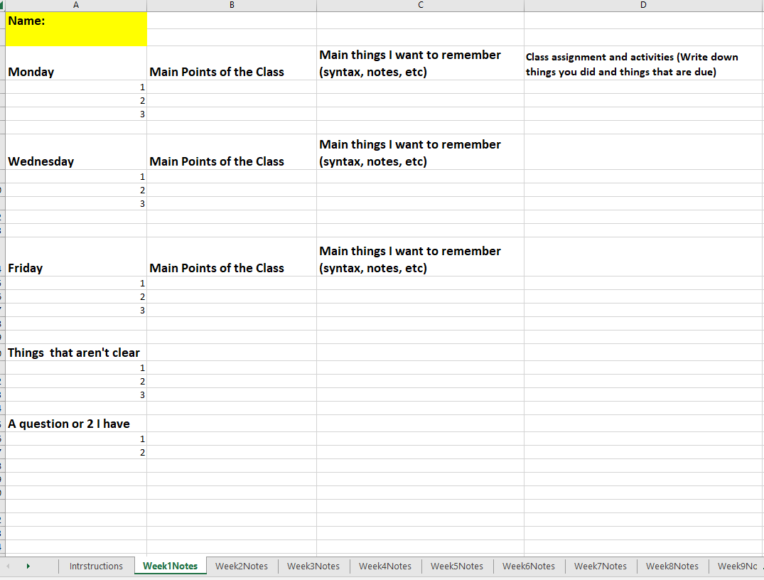
What will you put in here? The bare minimum? Or a series of things you want to make sure to remember? Paraphrase, paraphrase, paraphrase
Let me know items that are muddy. If its muddy for you … its likely to be muddy for others
Much of learning is driven by curiosity …

Slide 13
How your grade is determined – 45% HW/Projects
HW Early on … will stop around the MT
Project work (more on this later)
Early on … HW designed to give you practice … There is lots to learn …
Want that the ‘melt’ away and move into project

Slide 14
My Philosophies on …
Learning … growth mindset
fixed mindset -> believe that their basic abilities, intelligence, and talents are fixed traits. ...
.
If someone believes intelligence and abilities are immutable traits, they are not likely to put in much effort to change their inherent intelligence and abilities.
growth mindset => believe their abilities and intelligence can be developed with effort, learning, and persistence
https://www.developgoodhabits.com/growth-mindset-examples/
“It’s never too late to learn.”
“I can always improve at something if I try.”
“As long as I have determination, I can do anything.”
“If I am struggling it means I am learning”

Slide 15
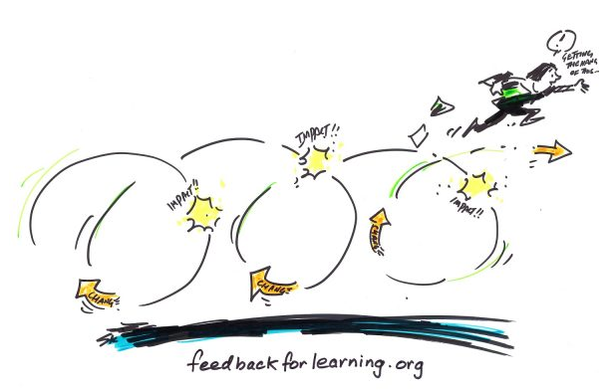
My Philosophies on …
The Learning Process
The Learning Process
In the field
1. Watch tutorial and code-a-long
(get it working)
2. Recreate with a twist
3. Study the example … Repeat steps 1,2 if needed …
4. Apply to a big project
As a student
Notes matter … in your own words
Practice matters
Use material ASAP

Slide 16



My Philosophies on …
Being Proactive about your learning
https://www.reddit.com/r/compsci/comments/5poqu6/how_do_you_take_notes_in_lectures/
I don't take notes at all. Everything you need to remember is on power points, the text book, internet. What you should do is spent 95% of your time just trying to understand what's going on. Use that remaining 5% asking questions.
I don't give a f*** if you're shy or don't want to be the annoying kid that asks questions. Be proactive. Sit in class to learn, not to record. If the prof tells you "X", ask why "X"? Why not "Y"? What happens to "X" if "Z" happens?
And after class is over, try to apply the knowledge. When you see how the knowledge you just acquired fits with previous knowledge, then you will have a deeper understanding.

Slide 17
What I expect …
Pro-active learning and participation
Going beyond lectures
Keeping track of your grade
Getting things done on time

Slide 18

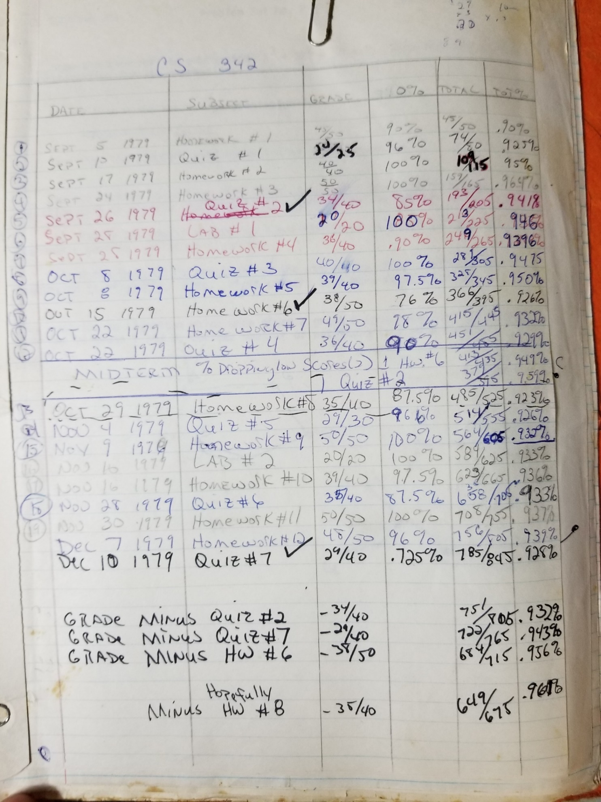
My Philosophies on …
Being Proactive about your grade
It’s a game … how well will you play it?
 | Quiz Item | Quizes/InClass Score | HW Item | Project/HW | MT item | Midterm | Final Item | Final | Total
Percentage |  | 0.15 |  | 0.45 |  | 0.15 |  | 0.25 | 1
 | Q1 | 100 | HW1 | 100 |  | 100 |  | 100
 |  | 100 |  | 100
 |  | 100 |  | 100
 |  | 100
Average |  | 100 |  | 100 |  | 100 |  | 100
Grade Pts |  | 15 |  | 45 |  | 15 |  | 25 | 100

Slide 19
